Slide 1
PHP & MySQL Lec1,2
Created By Eng. Ramy Ibrahim

Slide 2
What IS PHP ?
PHP = PHP: Hypertext Pre-processor.
PHP is an Open-source server side scripting language.
PHP is used to generate dynamic webpages.
PHP is an Interpreted language, scripts are parsed at runtime

Slide 3
PHP Pros
PHP can work with most of known web servers(Apache, IIS, etc.)
PHP can interact with many databases specially MySQL database.
Can be embedded into HTML
Source Code is not visible by client.
Has many build-in functions.

Slide 4
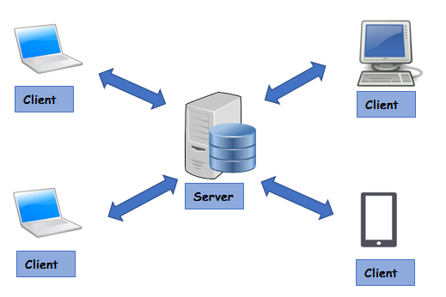
Client Server Architecture
Each client initiate the communication by sending HTTP Request Message using HTTP Protocol(GET,POST,PUT,DELETE).
The server replies with a HTTP Response Message
HTTP = Hyper text transfer protocol which is a type of TCP (Transfer control protocol)

Slide 5
How To Write PHP
<?php
//This is a php comment
/*
This is a php comment
inside a php multiline comment
inside a php tag
*/
$i=5; //must ends with ;
?>
Use PHP Tags inside PHP file <?php ?>
Each statement ends with semicolon (;)
Use //, /* */ ,# for comments

Slide 6
Variables in PHP
Must begin with $ sign.
Case-sensitive
Cannot Start with a number.
No special Characters except _
Global and Local Variables.
Reserved Variables ($_GET,$_POST,$_SESSION,$_SERVER)

Slide 7
Arrays
<?php
$arr =[‘Ahmed’ ,’Mohamed’, ’Maher’, ’Ramy’];
//This is a 0 –indexed array
$arr = [‘name’=>’Ahmed’ ,’age’=>’26’ ,’class’=>’Class A’];
//This is a key value pair array
?>
Arrays in PHP can be used as normal zero-indexed arrays
Also arrays can be used as Hashmap or Dictionary (key value pair array)
Key value pair cannot be accessed as $arr[0];

Slide 8
ECHO
<?php
echo ‘Hello’; //Hello $i=5;
echo $i;// 5
echo ‘i=$i’; // i=$i
//but
echo “i=$i”; // i=5
Echo is used to output the parsed parameter.
echo can be used to output HTML tags and values.
Use , to echo more than one parameter.
Use . To concatenate string.
Use var_dump() to debug and see the output of variables and arrays

Slide 9
Control Statements
If(condition){
Statement;
}
If(condition1){
Statement1;
}
else if(condition2){
Statement2;
}
If(condition1){
Statement1;
}
else if(condition2){
Statement2;
}
else{
Statement3;
}
IF
IF, ELSE IF
IF, ELSE IF, ELSE

Slide 10
Control Statements
$arr = [5,9,12,13,6];
$i=0;
while($i<count($arr)){
echo $arr[$i];
$i++; //very important
} //5 9 12 13 6
for($i=0;$i<count($arr);$i++){
echo $arr[$i].’ ‘;
} //5 9 12 13 6
foreach($arr as $a){
echo $a.’ ‘;
} //5 9 12 13 6
$arr = [‘name’=>’Ahmed’,’age’=>25];
foreach ($arr as $a){
echo $a.’ ‘;
}//Ahmed 25
foreach ($arr as $k=>$v){
echo $k.’=‘.$v.’ ‘;
}//name=Ahmed age=25
While loop
For loop
Foreach loop for arrays and key-value arrays

Slide 11
Functions
<?php
// This is a function
function foo($arg_1, $arg_2)
{
$arg_2 = $arg_1 * $arg_2;
return $arg_2;
}
$result_1 = foo(12, 3); // Store the function
echo $result_1; // Outputs 36
echo foo(12, 3); // Outputs 36
?>
Functions MUST be defined before then can be called.
Function headers are of the format
Functions are not case sensitive
function functionName($arg_1, $arg_2, …, $arg_n)

Slide 12
MySQL Database

